Slide 1
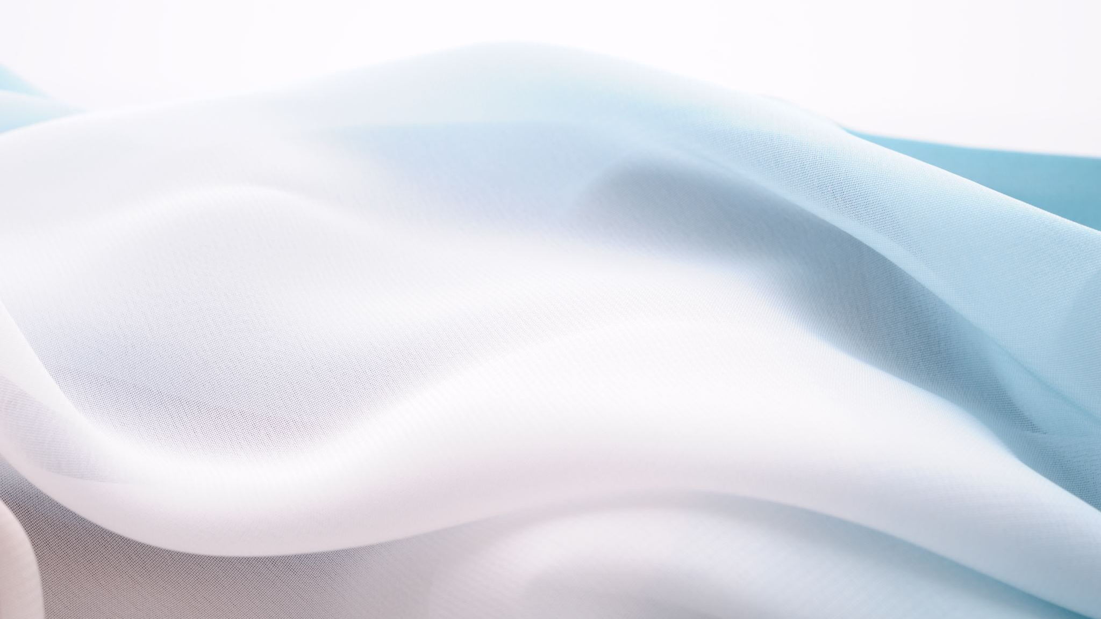
Class 7
Thursday, October 1, 2020
8 – 9pm

Slide 2
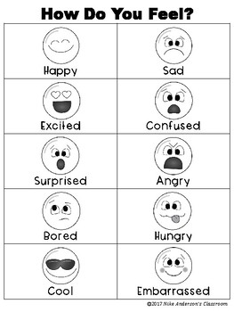
Checking in
Stressed = estresada
How are you feeling today?
Today I feel _________
What did you do today?
Today I _________

Slide 3
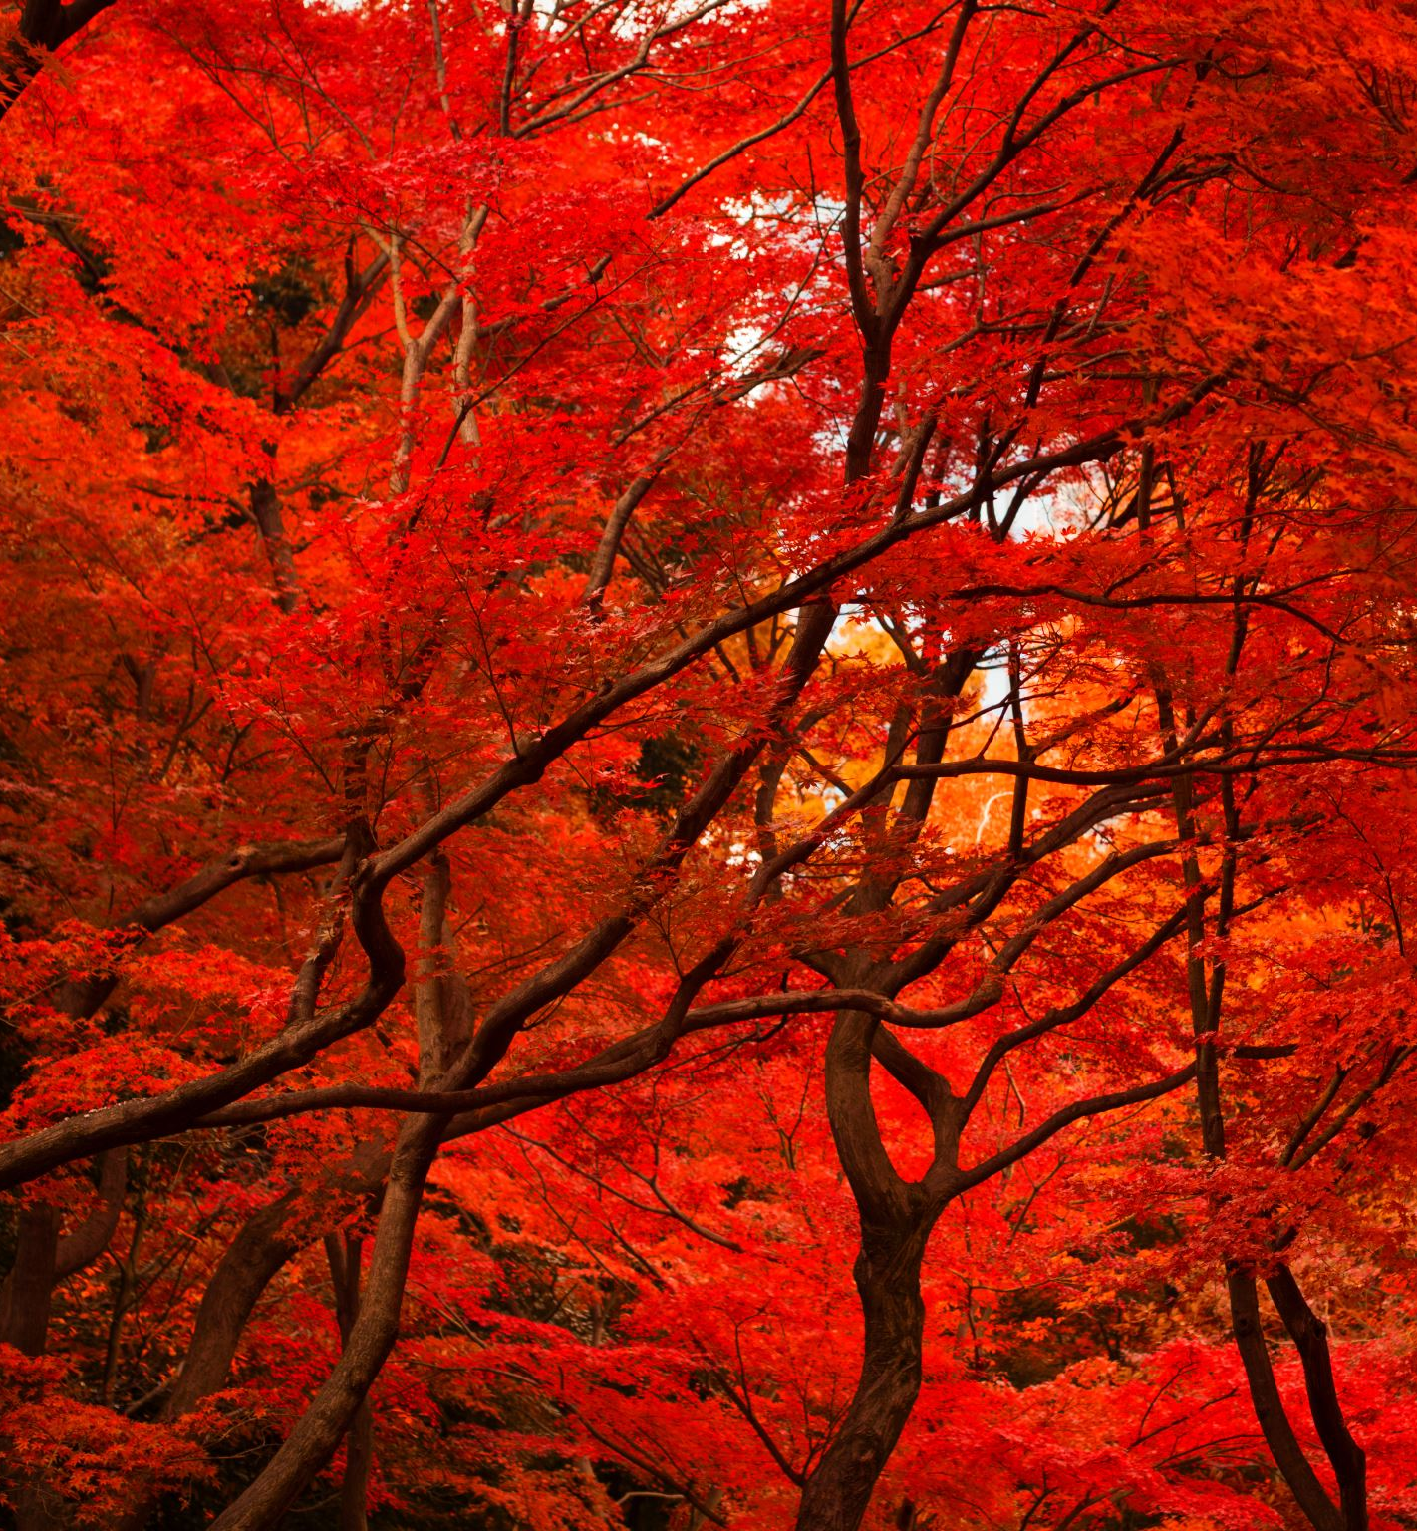
It is the month of October! … What things do you associate with this month?
Fall, Autumn
Foliage, (leaf) leaves falling
Winter is near
Cool weather

Slide 4
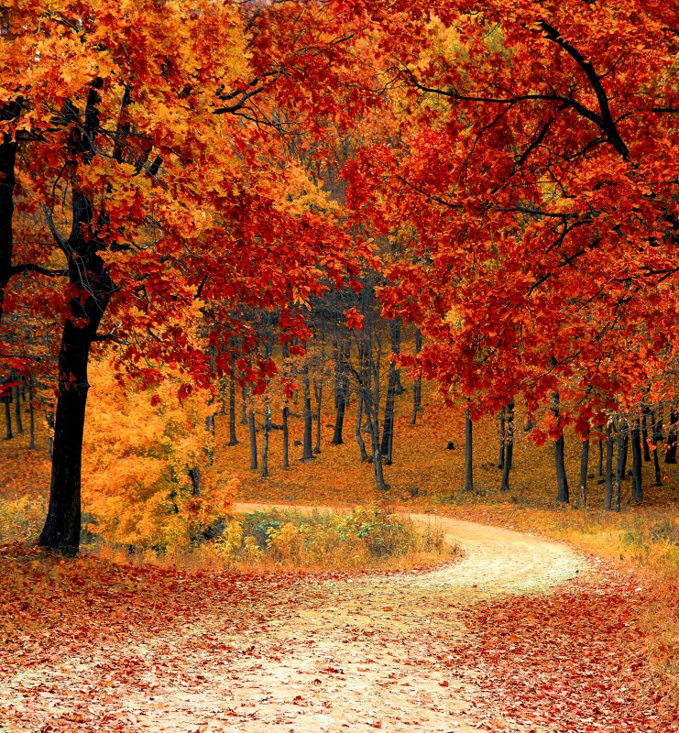
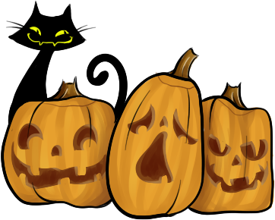
When I think of October, I think of…
Fall/Autumn
Trees
Leaves falling
Colors: orange, yellow
Rain, wind, chilly weather
Apple picking
Halloween
Costumes
Candy
Pumpkins
Colorful

Slide 5

Review from past classes
The 5 W’s + How → Asking questions
Who → quem
What → que?
When → cuando
Where → onde
Why → por que
How → como
What is a noun?
Count nouns (next slide)

Slide 6
Count nouns VS non-count nouns
Count nouns
Non-count (uncountable) nouns
Can be separated into individual units and counted
Eye, hand, ear, finger, leg
Singular vs plural form
Plural form → add s at the end
Eyes, hands, ears, fingers, legs
Exist as masses or abstract quantities that can’t be counted
Water, wood, air, rice, sunshine, rain, soccer
Generally can’t be pluralized

Slide 7
Activity: categorize the nouns
Wind
Count nouns
Box
Non-count nouns
Sugar
Wolf
Wood
Computer
House
Wine
Sunshine
Pen

Slide 8
Plan for today
Today we will learn about possessive nouns
What are they?
Differences between Portuguese and English
Today’s plan

Slide 9
Possessive nouns

Slide 10
Possessive nouns
Possessive nouns: used to indicate ownership
Show that a person, place, or thing owns something
Usually are formed by adding an apostrophe (‘s) and s
Beverly’s pen
Felipe’s eyes
Grandma’s house

Slide 11

Translating from Portuguese to English
Este é o livro de Beverly.
Direct translation: This is the book of Beverly.
Correct translation: This is Beverly’s book.

Slide 12
Translating from Portuguese to English
Os olhos do Felipe são azuis.
Direct translation: The eyes of Felipe are blue.
Correct translation: Felipe’s eyes are blue.

Slide 13
Translating from Portuguese to English
Esta é a casa de minha avó.
Direct translation: This is the house of my grandmother.
Correct translation: This is my grandmother’s house.

Slide 14
Summary: rules for possessive nouns (rule 1 & 2)
 | Does not end in s | Ends in s
Singular | Add ‘s | Add ‘s
Plural | Add ‘s | Add ‘

Slide 15
Activity: make the singular nouns possessive
Examples:
Felipe → Felipe’s
Cat → cat’s
Brazil → Brazil’s
Computer → computer’s
Practice:
Phone → ___________
Sun → ___________
House → ___________
Dog → ___________
Tree → ___________
Grandmother → ___________
Country → ___________
Phone’s
Sun’s

Slide 16
Activity: make the plural nouns possessive
Examples:
Hands → hands’
Trees → trees’
People → people’s
Feet → feet’s
Practice:
Monsters → __________
Teeth → __________
Eyes → __________
Spiders → __________
Pumpkins → __________
Parents → __________
Monsters’
Teeth’s
Eyes’

Slide 17
Some rules about possessive nouns
Singular possessive nouns: formed by adding ‘s at the end
Grandmother’s house
Plural possessive nouns [and plural possessive nouns that end in S]: when a noun is plural, just add the apostrophe (‘)
Casa dos meus pais → My parents’ house
Os cadernos de estudante → The students’ notebooks
If two people own one thing, add the apostrophe and s to the second person only
A filha de Hector e Hilda → Hector and Hilda’s daughter
If two people own separate things, add the apostrophe and s for each
Os quartos de Yasmin e Andy → Yasmin’s and Andy’s rooms
Notes:
LEFT OF HERE

Slide 18
Activity
Baby → babies, baby’s
Singular possessive nouns
Plural possessive nouns
Example: France’s soccer team is one of the best. (France)
_________ book is in his backpack. (Felipe)
The __________ window is broken. (House)
The __________ toy is in the room. (Baby)
My __________ name is Felipe. (Son)
My __________ name is Andy. (Brother)
Example: The books of the students.→ The students’ books.
The tools of the doctors. → ________________________________
The toys of the children. → ________________________________
The parents of the girl. → ________________________________
The cheeses of the mice → ________________________________
Felipe’s
House’s
The doctors’ tools
Baby’s
The children’s toys
Son’s
Brother’s
The girl’s parents
The mice’s cheeses

Slide 19
Activity: write the correct possessive form of the singular nouns
The food of the dog → the dog’s food
The hat of the woman → _________________
The window of the car → _________________
The eyes of the wolf → _________________
The population of Brazil → _________________
The son of Thais → _________________
The woman’s hat
The car’s window
The wolf’s eyes
Brazil’s population
Thais’s son

Slide 20
Activity: translate from English to Portuguese
The wolf’s eyes are big.
Os olhos do lobo são grandes.
Felipe’s sweater is red.
O suéter do Felipe é vermelho.
Brazil’s population is 212 million.
A população do Brasil é de 212 milhōes.
Felipe is Thais’s son.
Felipe é filho de Thais.

Slide 21
Activity: translate from Portuguese to English
Essa é a casa de Ana.
_________________________________________
Os olhos do Felipe são azuis.
_________________________________________
Felipe é filho de Thais.
_________________________________________
Português é a língua oficial do brasil.
_________________________________________
Quando é o aniversário da sua mãe?
_________________________________________
That is Ana’s house
Felipe’s eyes are blue
Felipe is Thais’s son
Portuguese is Brazil’s official language
When is your mother’s birthday?

Slide 22
Answering questions using possessive nouns
What is your son’s name?
____________________________________
When is Felipe’s birthday?
____________________________________
What is Thais’s favorite food?
____________________________________
What is Beverly’s last name?
____________________________________
My son’s name is Felipe
The Felipe’s birthday is July 15.
Thais’s favorite food is pizza.
Beverly’s last name is Reyes.

Slide 23
Any questions on possessive pronouns?

Slide 24
Pronouns
Notes:
Left of here!

Slide 25
Pronouns
Pronouns: takes the place of a noun
Example story:
Beverly is 21 years old. Beverly is a student at Tufts University. Beverly is studying Community Health. Beverly’s house is in Connecticut and Beverly lives with Beverly’s parents.
Example story using pronouns:
Beverly is 21 years old. She is a student at Tufts University. She is studying Community Health. Her house is in Connecticut and she lives with her parents.

Slide 26
Personal pronouns
Personal pronouns: refer to a person
Usually replace a name
Examples:
I go to school
She works at the bakery
They are in class
We meet on Thursday nights
He is my son

Slide 27
Pronouns that refer to objects
“It” refers to an object
Examples
I love food → I love it
The house is big → It is big
They cut the cake → They cut it

Slide 28
Personal pronouns: subjective pronouns
Singular pronouns |  | Plural pronouns
I |  | It
You |  | You (you all)
He, she, it |  | They

